Slide 1
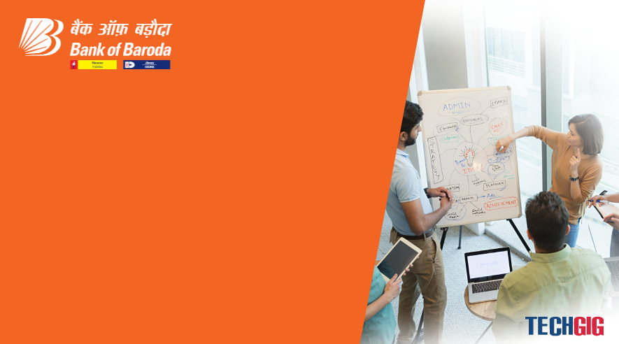

Bank of Baroda Hackathon - 2022
Technology Partner
Your Team Name: Technophiles
Your team bio: Together we learn, together we strive
Date: 20 September 2022

Slide 2
Problem Statement
Why did you decide to solve this Problem statement?
Despite rapid advancements in digital technology, financial institutions continue to rely on the traditional method of processing bank cheques by humans which is a tedious and time consuming task. This affects the end users as the transactions may take upto a few days to reflect in the bank accounts.
Moreover, relying just on physical means for processing large quantities of data can also be less efficient and prone to security breaches. This also accumulates to the total costs and resources for executing the process.
Digitalising this can also help in getting statistical analysis on the number of transactions and build models accordingly for the bank to work better.
So we believe that this model that we propose here will bring up the efficiency and performance of the same to a whole new level and hence this problem statement pleases us the most.

Slide 3
User Segment & Pain Points
Which user /advertiser segment would be early adopter of your product & why?
Smaller organizations can implement this product better in the testing stages so that the model can be further trained for better accuracy and speed.
This product will be mainly used by the banks for an efficient way to process cheques and also save time so that, more clients can approach the bank on a daily basis. This will improve the number of clients and thereby making the bank or organization more trustworthy.
Banks like Bank of Baroda which takes in a large amount of cheques can use this product to increase the cheque processing capabilities and in turn help the bank to earn more and provide better offers for its clients which increases the financial activities of the bank and thereby increasing their profits.

Slide 4
Prerequisite
What are the alternatives/competitive products for the problem you are solving?
There are automated systems which extract relevant details of a bank cheque like Payee Name, Amount, Date, Bank Name using Optical Character Recognition and Deep Learning and verify the signature on the cheque with the existing signature stored in the database using feature extraction and principal component analysis.
These systems make use of a modified convolution neural network to extract the handwritten content on cheque leaf where in IAM dataset is used to train the model and get the optimized results.

Slide 5
Azure tools or Resources
→ GitHub
→ VS Code
→ Microsoft Excel
→ Microsoft Azure AI - Computer vision
→ Microsoft Azure AI - Machine Learning
→ Microsoft Azure AI - Natural Language Processing
→ Azure Form Recogniser
→ Translator

Slide 6
Any Supporting Functional Documents
Firstly, the cheque leaf is scanned and the image is stored. Then, this image is used for the validation process.
The Account Number on the cheque is checked with the database of accounts. Then the parameters like Name, Amount (both in words and digits) and date (For validity verification) are extracted.
Following are the steps and features of the validation process:
→ Scanning the cheque leaf
→ Setting up the position
→ Multilingualism (Extracting data written in different regional languages)
→ Handwriting recognising efficiency
→ Signature verification
→ Validating the MICR number
→ Checking whether it is an A/C payee or a crossed cheque (A text written in the top left corner)

Slide 7
Key Differentiators & Adoption Plan
How is your solution better than alternatives and how do you plan to build adoption?
Our solution extracts content from the handwritten text on the cheque. It also converts the text of other languages to English and allows the user to make changes to it if required.
Signature verification is done by comparing the signature with the ones in the database. This is done with the help of OpenCV and the concept of Image Thresholding. Then the MICR number validation is done by comparing with actual MICR numbers provided by the bank. Finally, it is checked whether the cheque is an A/C payee or not from the extracted text.
All these above mentioned features enables our model to stand out from the rest.
We can provide a good and easy-to-use user interface (UI) for the bank to automate the processing of cheques which is way better than the existing scenario of manual cheque processing.

Slide 8
GitHub Repository Link & supporting diagrams, screenshots, if any
How far it can go?
Flowchart: https://cloud.smartdraw.com/share.aspx/?pubDocShare=1E3C1FF9C3814A71457C18680B4B5FAEC93
Notion Workspace:
https://festive-dive-9e1.notion.site/BoB-Hackathon-38bb5a2169014eb99e8abedffaea35cd
GitHub:
https://github.com/AshiqNoor-S/Team_Technophiles

Slide 9
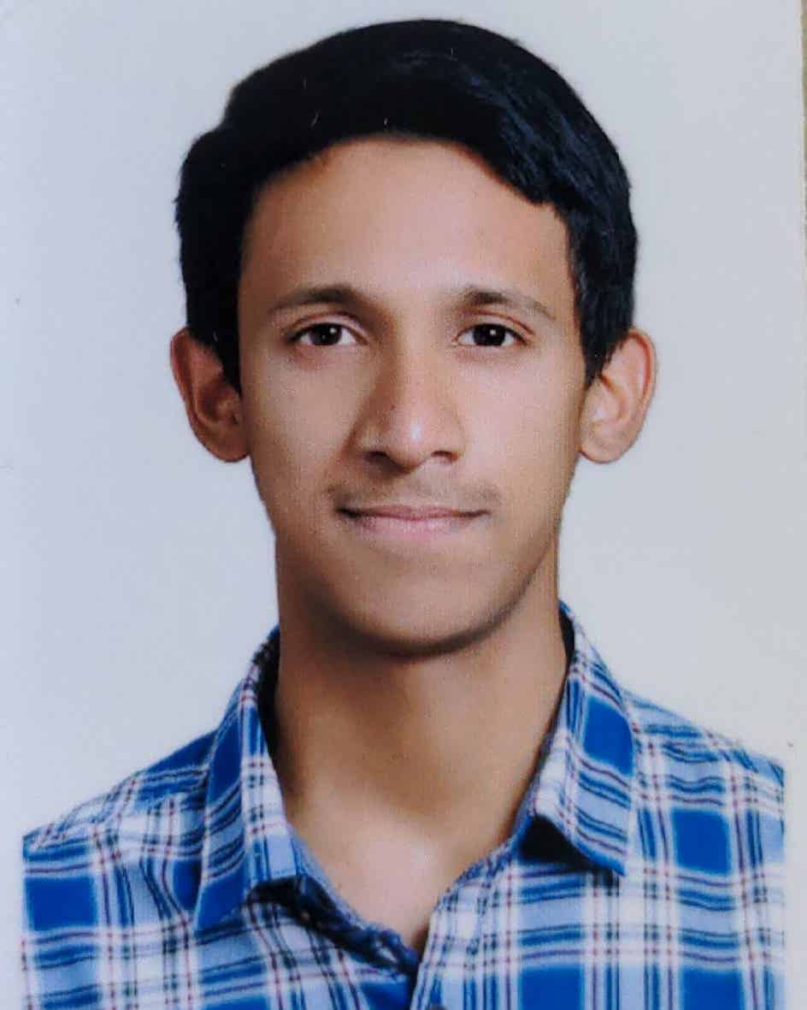
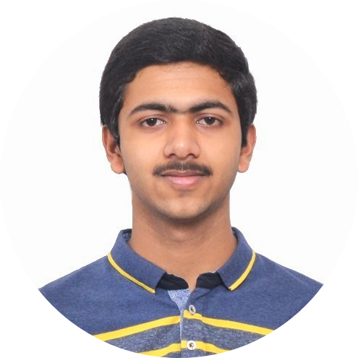
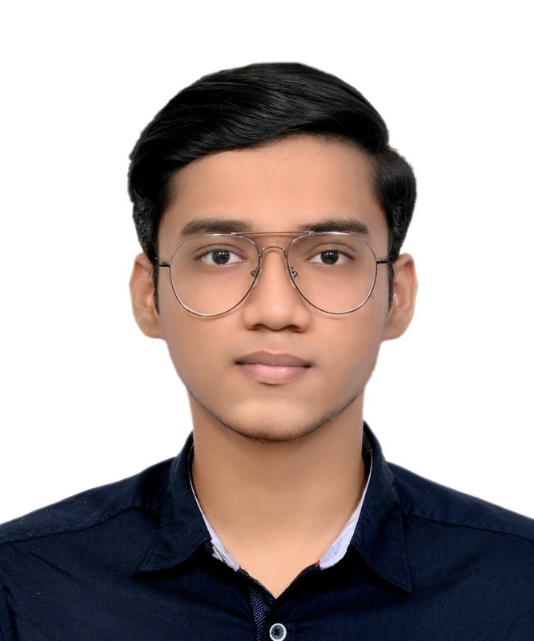
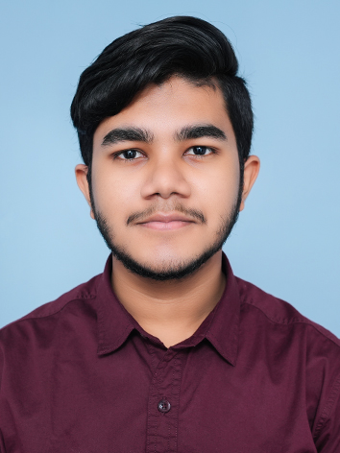
Team Members !!
Ashiq Noor Sudheer
Mathew Thomas
Priyanshu Pattanaik
Bharat Pandiyan

